Slide 1
An Industrial Knowledge Representation for Kit Building Applications
S. Balakirsky, Z. Kootbally, C. Schlenoff, T. Kramer, S. Gupta
Presented by: Stephen Balakirsky

Slide 2
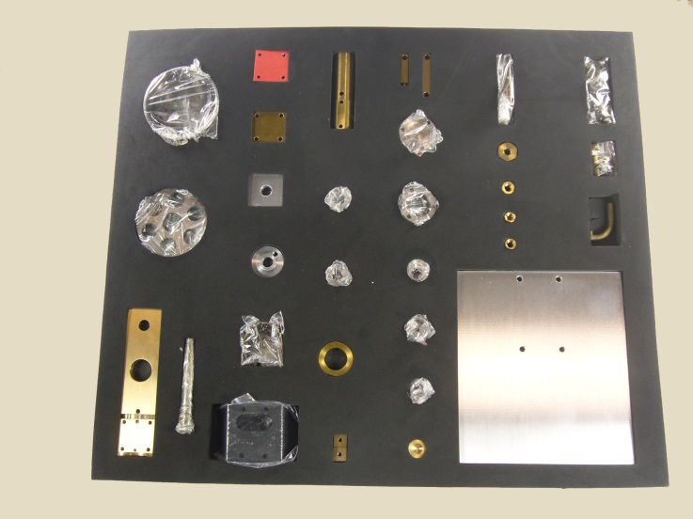
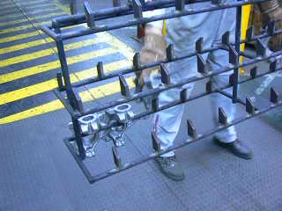
Kit Building
Process in which individually separate but related items are grouped, packaged, and supplied together as one unit
Utilized in many manufacturing assembly lines
Robotic solution requires:
Flexibility –Many parts with varying characteristics, part-to-part inconsistences
Agility – Changes in part supply locations, lack of fixturing
Rapid re-tasking – Ability to quickly build new varieties of kits

Slide 3
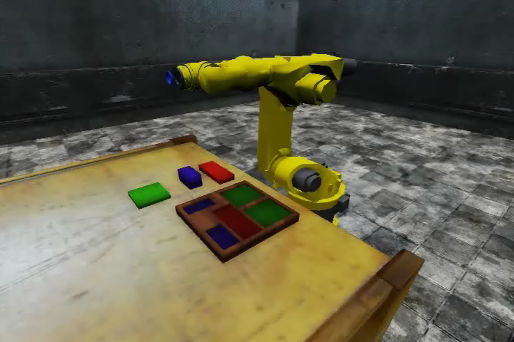
Real Planning / Simulated Robot
Video is 2x real time

Slide 4
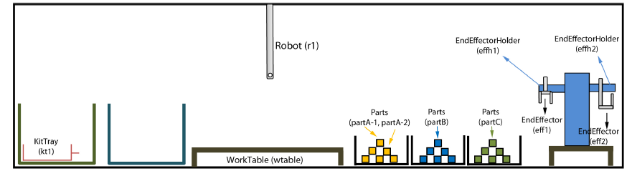
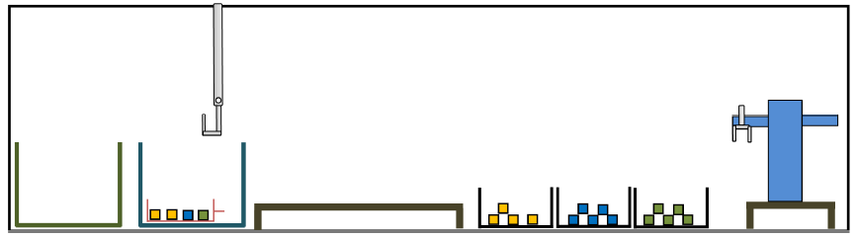
Planning Problem
Ƥ = (Ʃ, s₀, g)
Ʃ - State transition system (possible actions)
S₀ - Initial conditions (objects and relationships)
g – Goal conditions
Initial Condition
We would like to examine the knowledge requirements of this planning problem
Goal Condition

Slide 5
Underlying Knowledge Representation
Objects
What objects and attributes are relevant
Taxonomy of objects
Relationships between objects
Actions
What actions and attributes are relevant
Necessary conditions for an action to occur
Likely results of the action
Dynamic world
Object attributes change over time
Actions do not always accomplish what we want them to

Slide 6
Objects, Relationships, and Actions
State-Variable Representation¹ (SVR) used to formally define environment’s objects, object relations (state), and actions
Each state is represented by a tuple of values of n state variables {x₁,…, x_{n}}
Action is represented by a partial function that maps this tuple into some other tuple of values of the n state variables
SVR is not a standard interchange language
Can encode the SVR into Planning Domain Definition Language (PDDL)
¹Dana Nau, Malik Ghallab, and Paolo Traverso. 2004. Automated Planning: Theory & Practice. Morgan Kaufmann Publishers Inc.

Slide 7
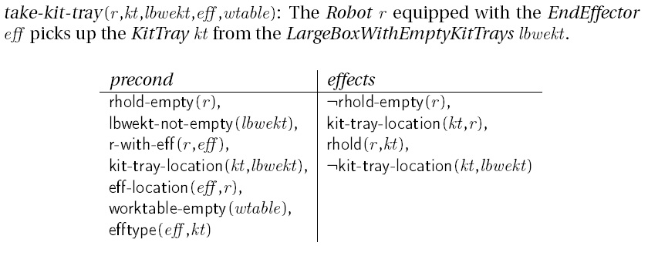
Planning Domain Definition Language (PDDL)
Entire kitting domain composed of:
28 predicate expressions that act as preconditions or are acted upon during effects: rhold-empty, r-with-eff, kit-tray-location, worktable-empty, …
9 high-level operators (actions): take-kit-tray, put-kit-tray, take-kit, put-kit, take-part, put-part, attach-eff, remove-eff, create-kit

Slide 8
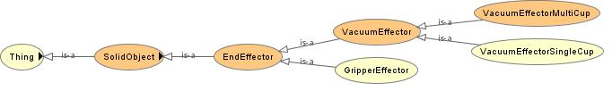
SVR - PDDL Limitations
Planning language not designed for knowledge representation
Lacks a taxonomy of objects
No representation of relationships or constraints between objects
An ontology provides for all of the above through entities, data properties, and object properties
Web Ontology Language (OWL) can be used to represent objects, relationships, and constraints
OWL Services (OWL-S) and the Semantic Web Rule Language (SWRL) can be used to represent actions, preconditions, and effects
Tools exist to move from OWL and OWL-S/SWRL to PDDL representations
Example Class Hierarchy

Slide 9
Dynamics
Set of static files with no real-time information
Can auto-generate MySQL database from OWL instance file and maintain database with sensor processing
Can re-generate OWL instance file to allow for continued reasoning
Now have a hybrid knowledge structure
OWL, OWL-S/SWRL for static snapshot of information
MySQL for dynamic knowledge

Slide 10
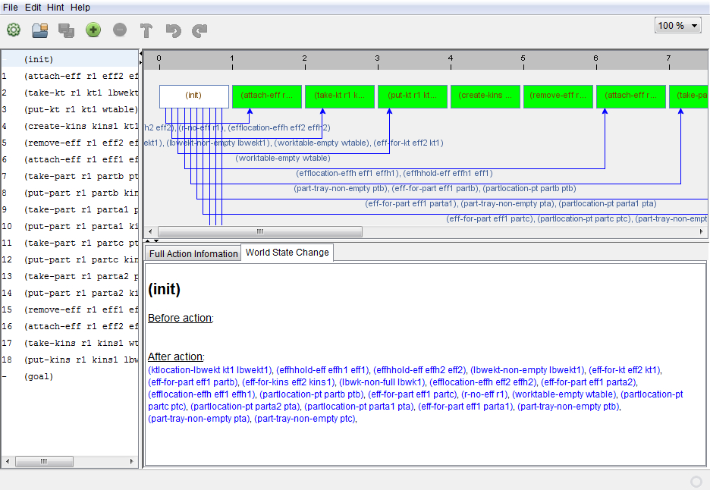
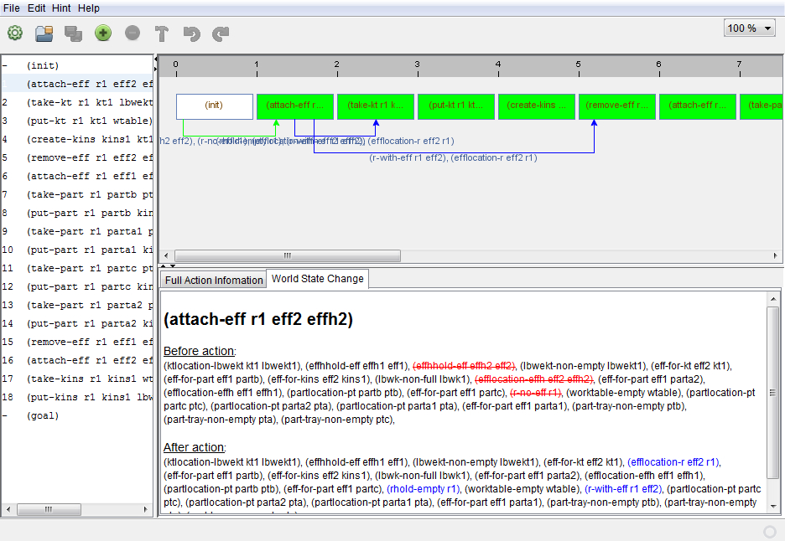
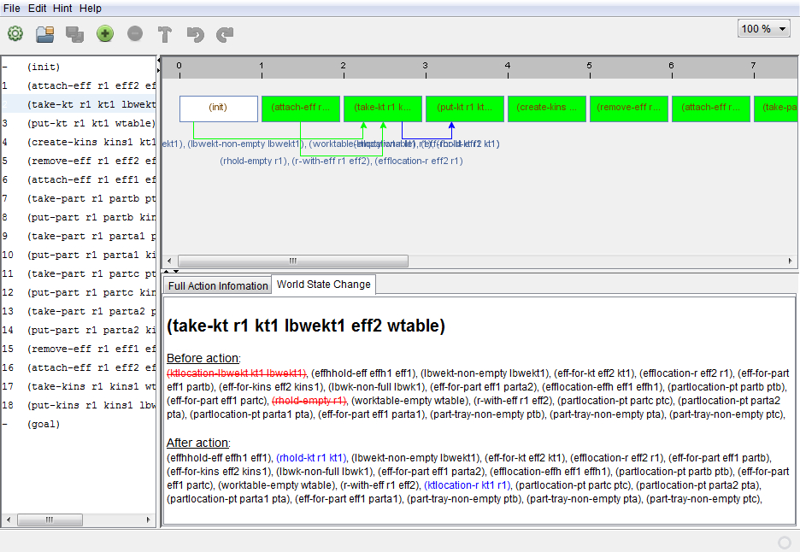
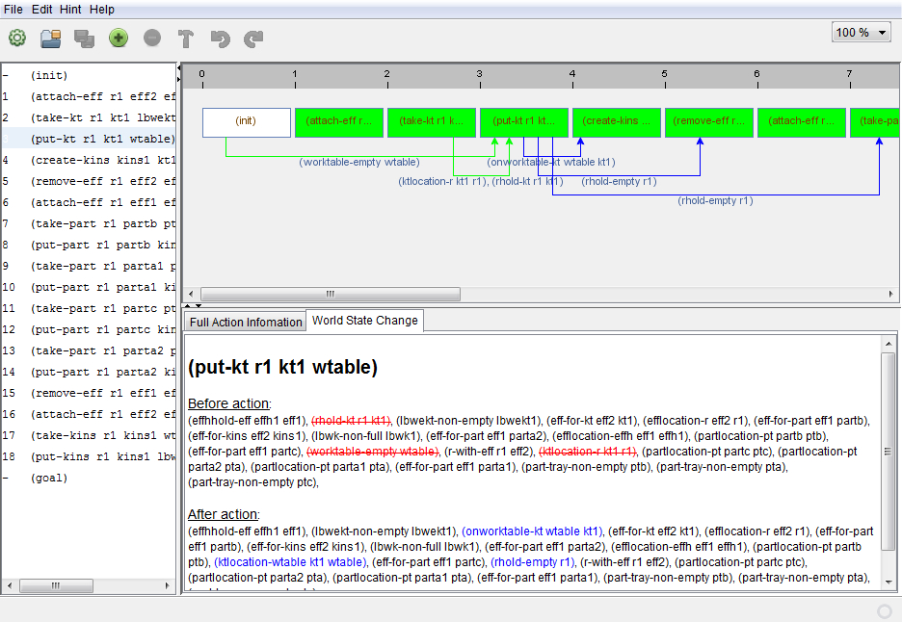
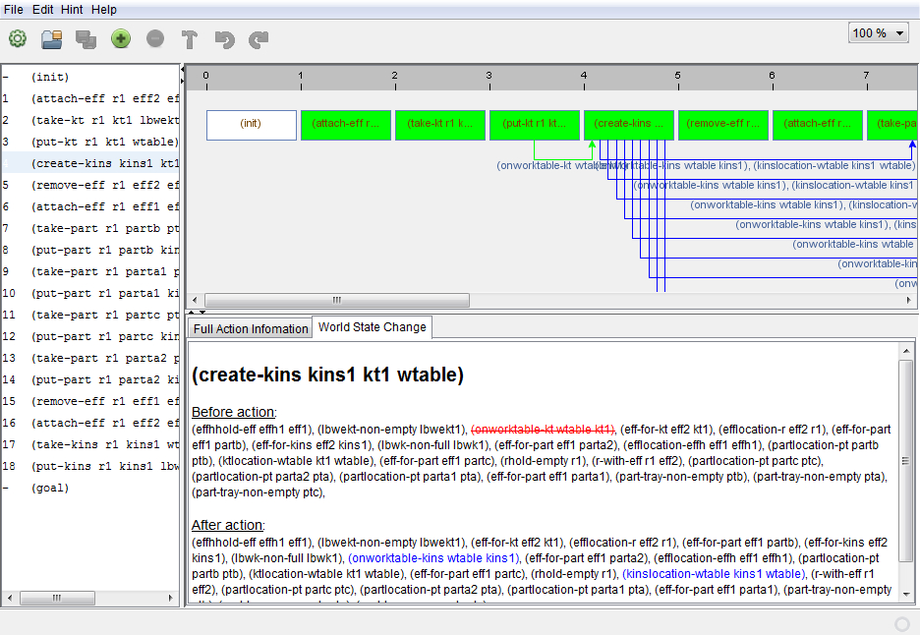
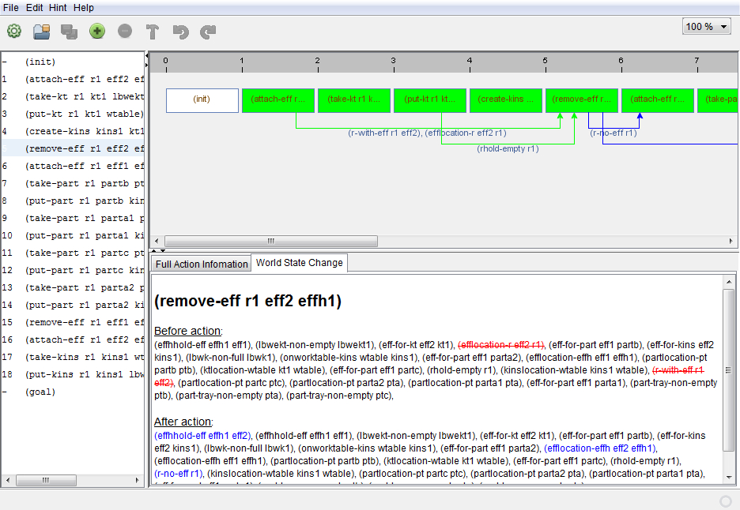
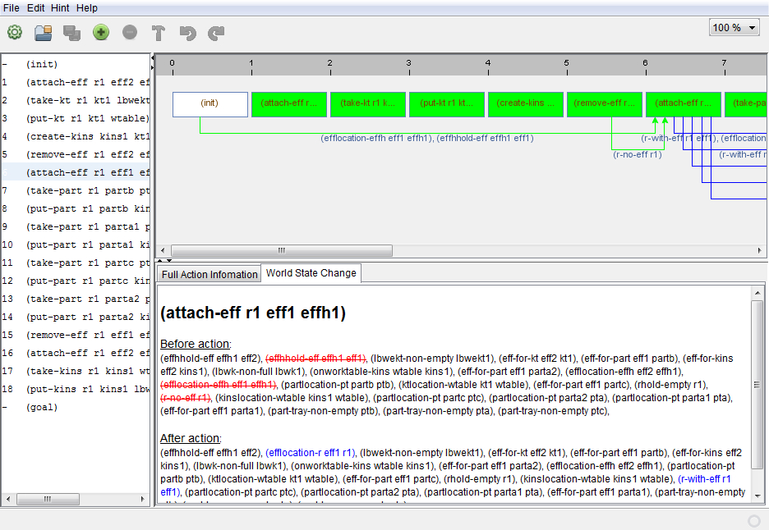
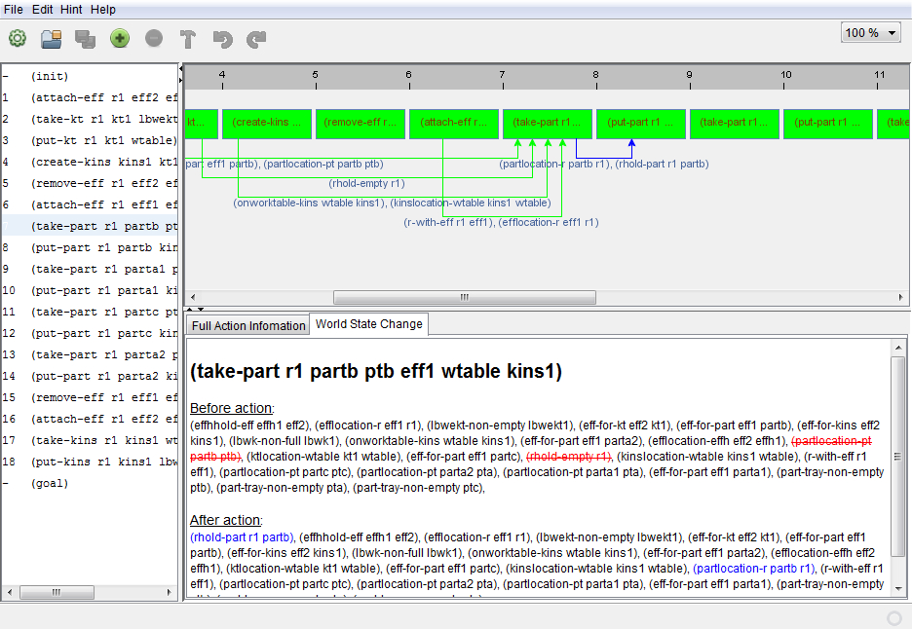
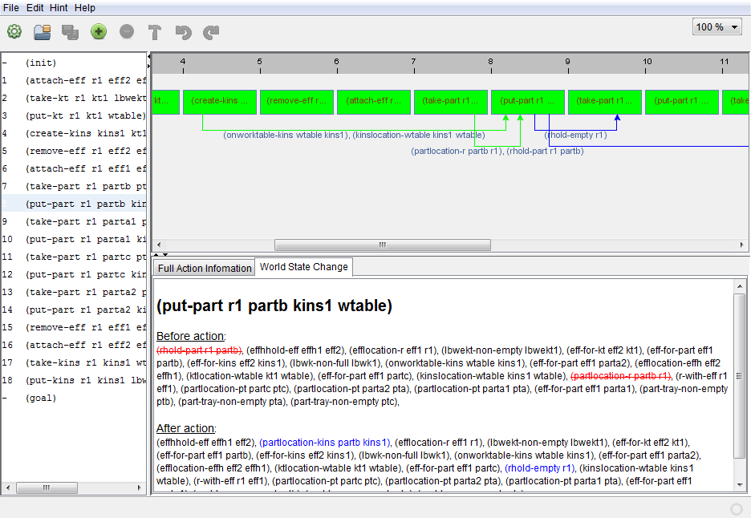
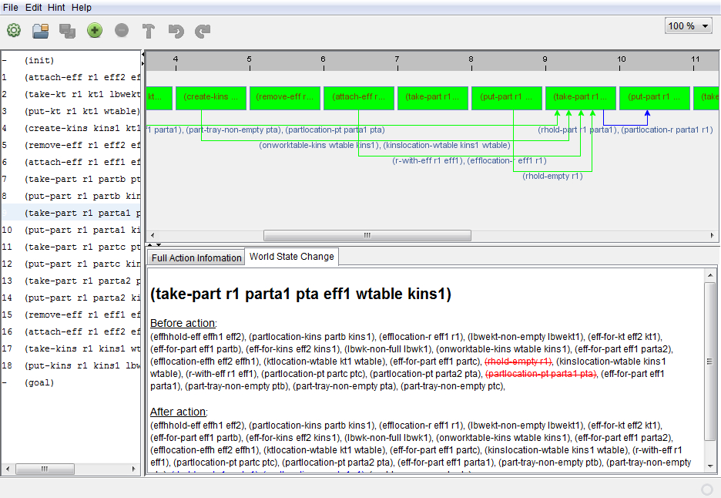
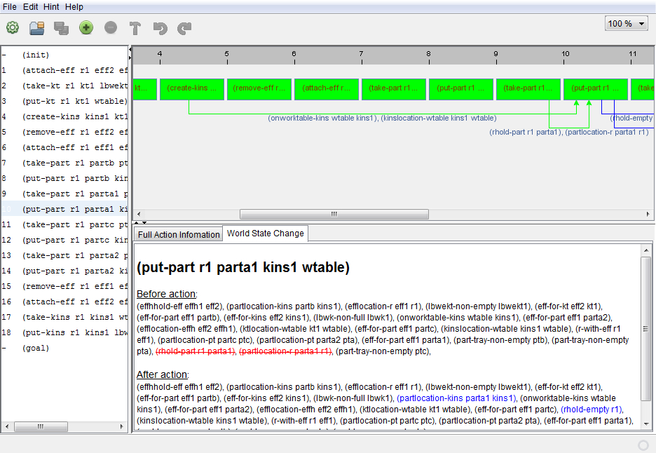
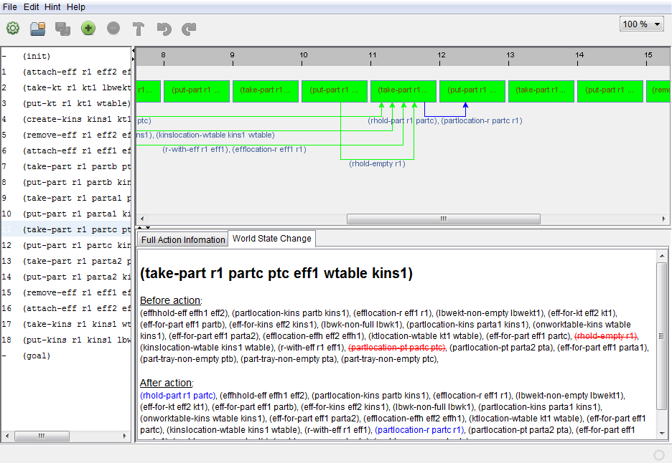
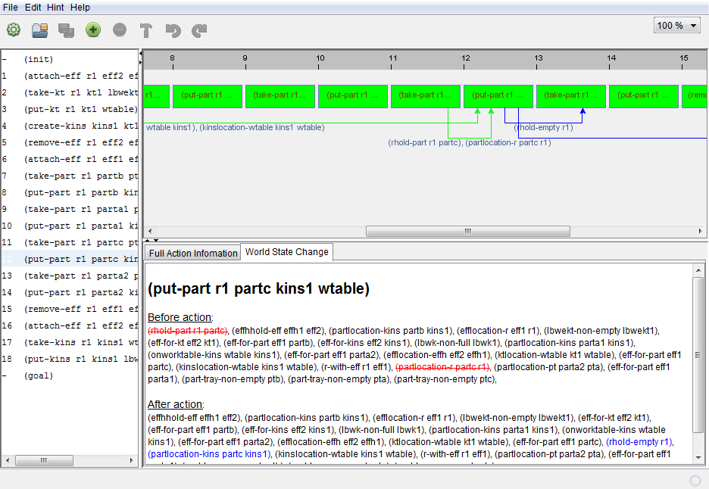
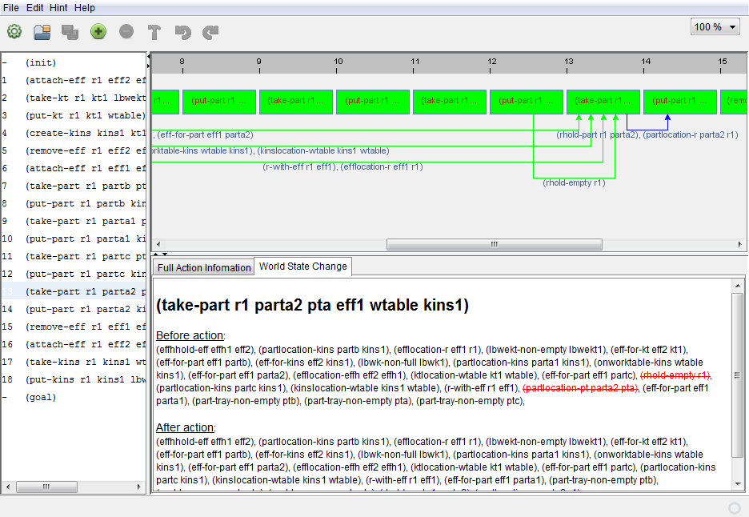
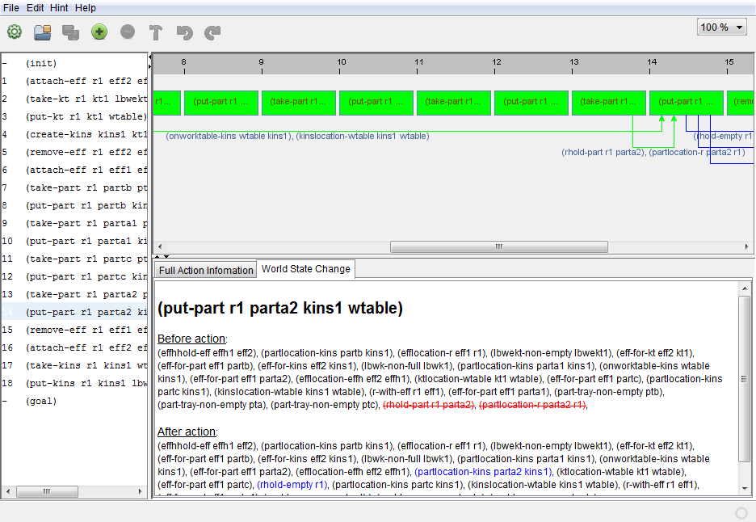
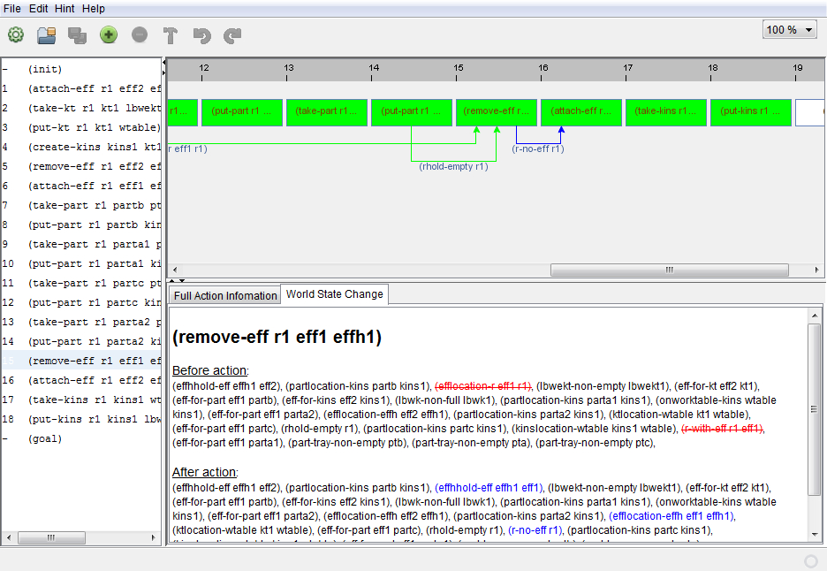
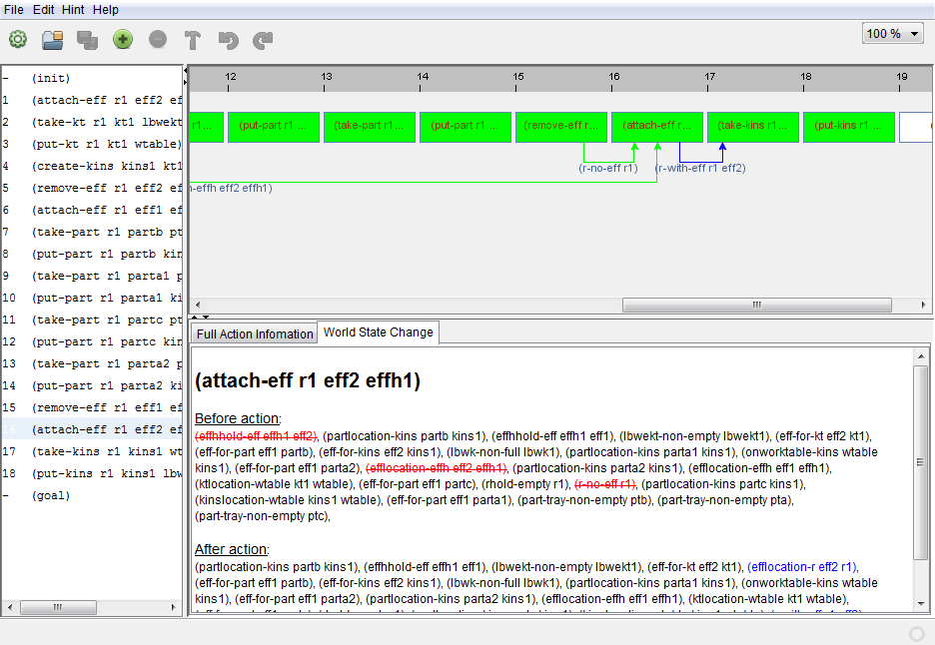
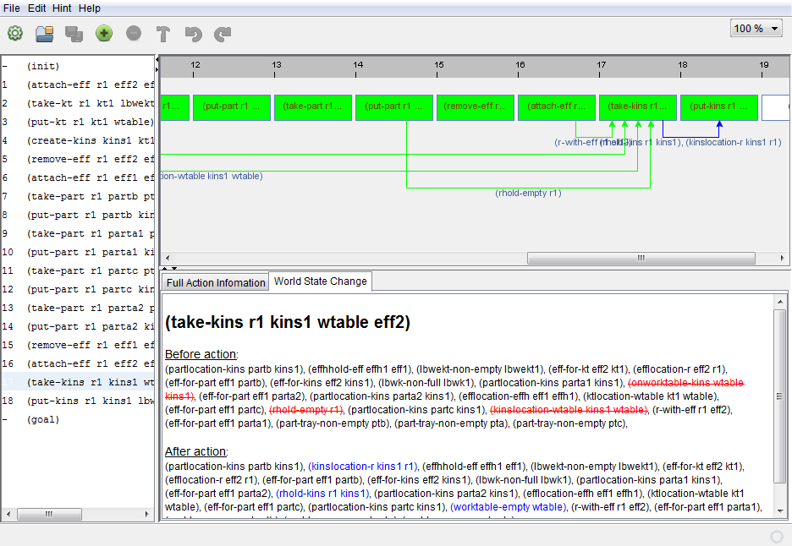
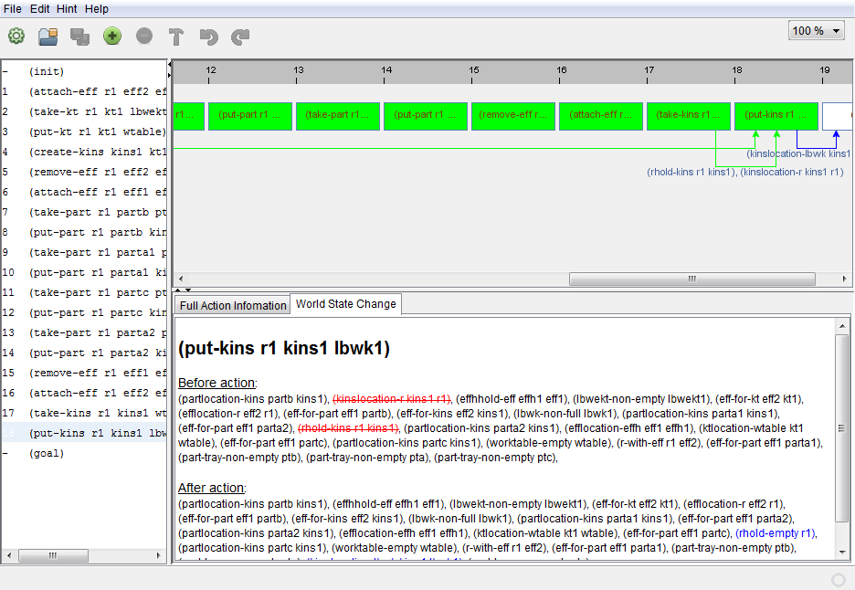
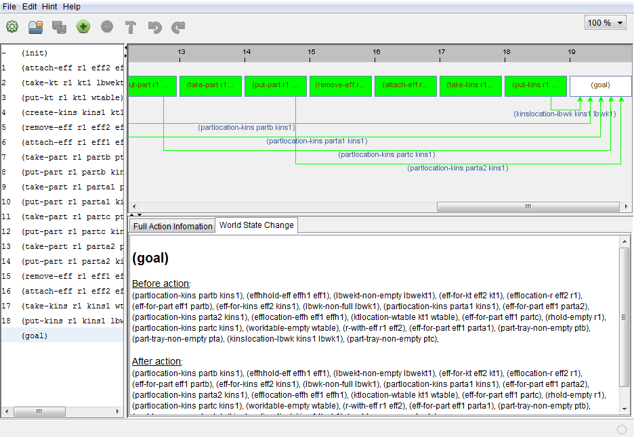
Planning System in Action

Slide 11
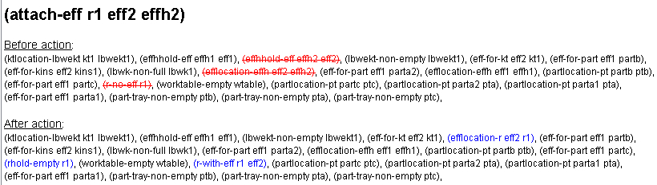
PDDL Plan Instance File
Intentionally incomplete information
Command provides task-level information; most robots will not know how to “attach-eff”
Specific information needed to accomplish task is missing
This intentional lack of information provides for decoupling of task knowledge and environment knowledge
Executor module populates the details
Combines task knowledge from PDDL with environment knowledge from MySQL
Utilizes “Canonical Robot Command Language” as an Interlingua

Slide 12
Example: attach-eff r1 eff2 effh2
Subcommand | PDDL | MySQL | Data Update
Move | R1, effh2 | Actual locations, offsets | ---
Actuate | R1 |  | R1 holds eff2 effh2 empty
Move | R1 | Offsets | ---
Must have mapping between PDDL actions and required robot sub-actions
Must update knowledge base (MySQL)
MySQL knowledge base contains all data from ontology needed by planner

Slide 13
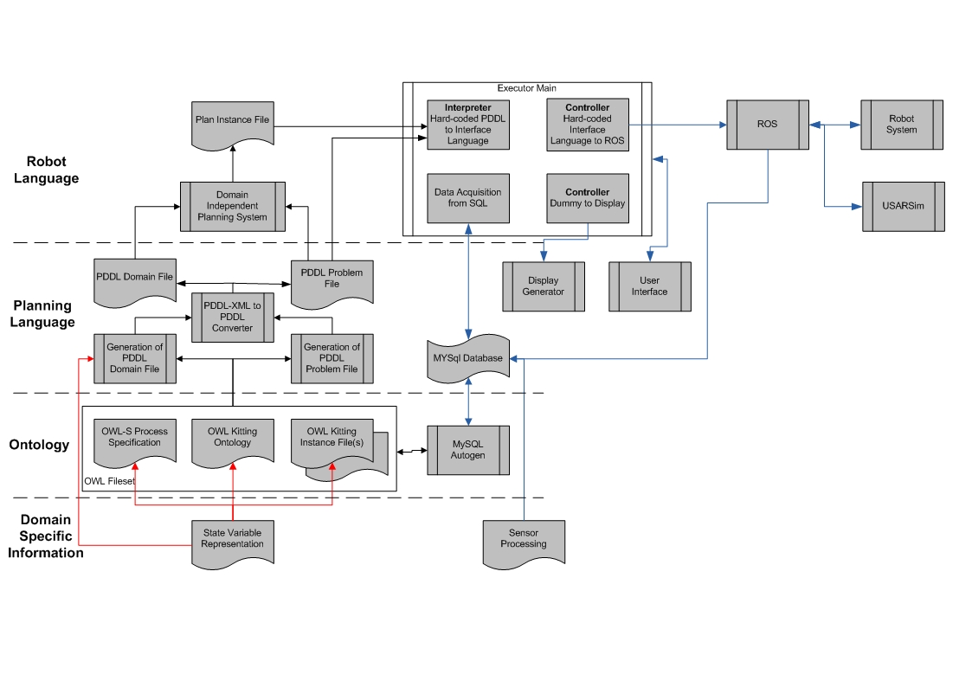
Complete System Architecture

Slide 14
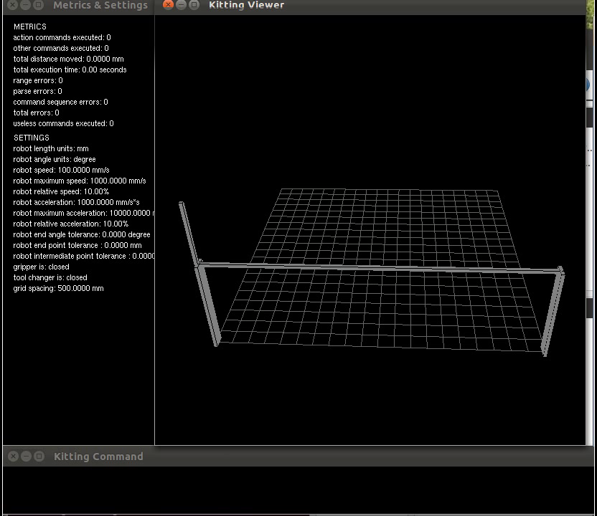
Future Work, Metrics
Time to build
Distance robot traveled
Number of actions
Useless commands
Errors
…

Slide 15
Future Work
Current work assumes perfect actions; need techniques to gracefully cope with errors
Migrate techniques onto real hardware with real image processing
Extend work to apply to general assembly operations

